Slide 1
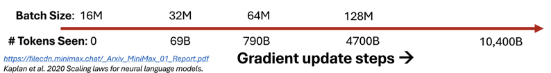


Slide 2
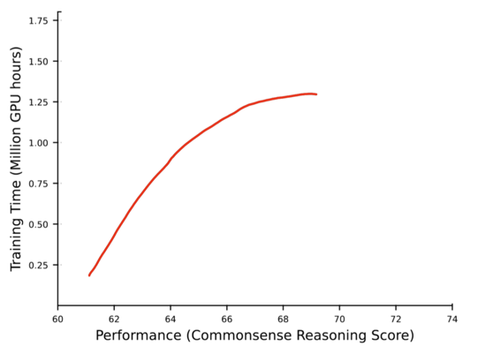


Slide 3
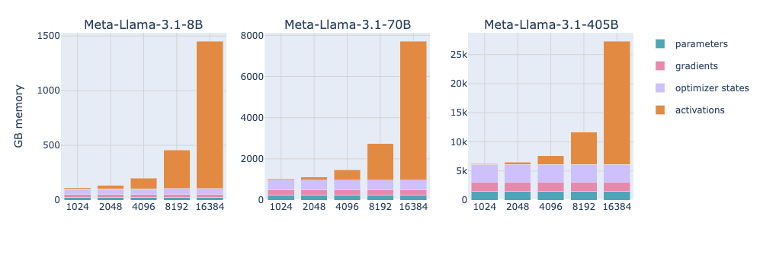
Sequence Length
Sequence Length
Sequence Length

Slide 4
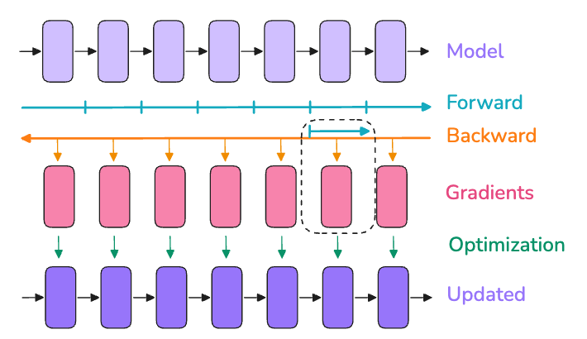
→ Storing the activation only here

Slide 5
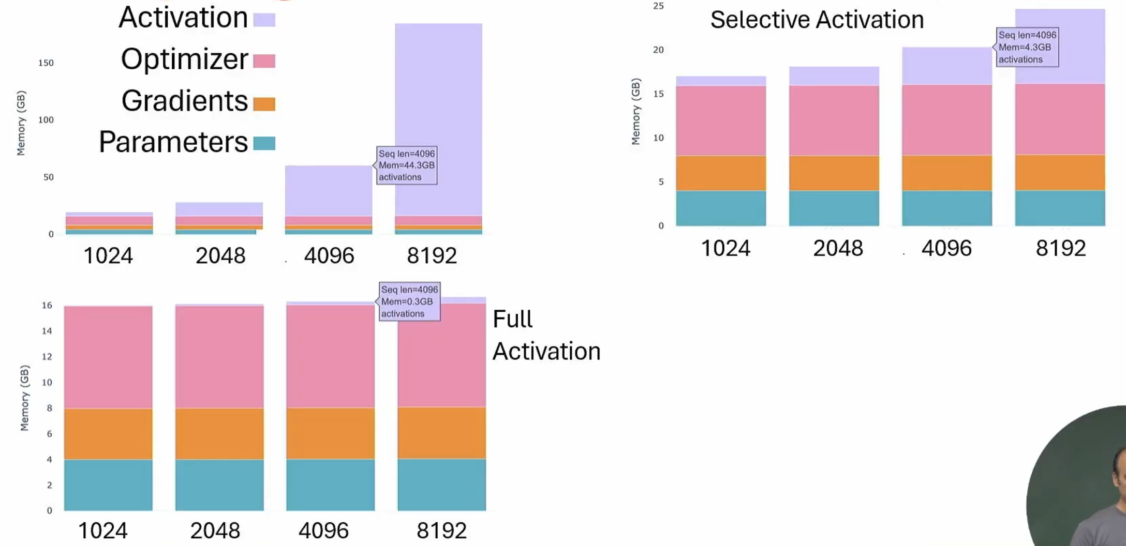


Slide 6

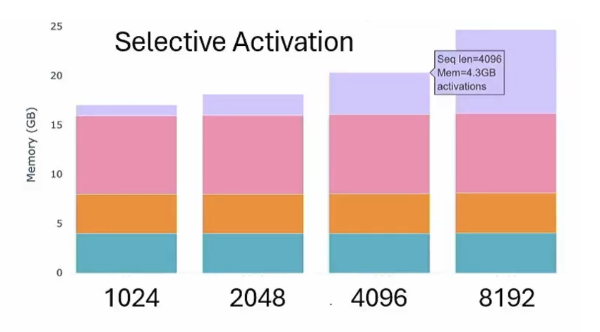
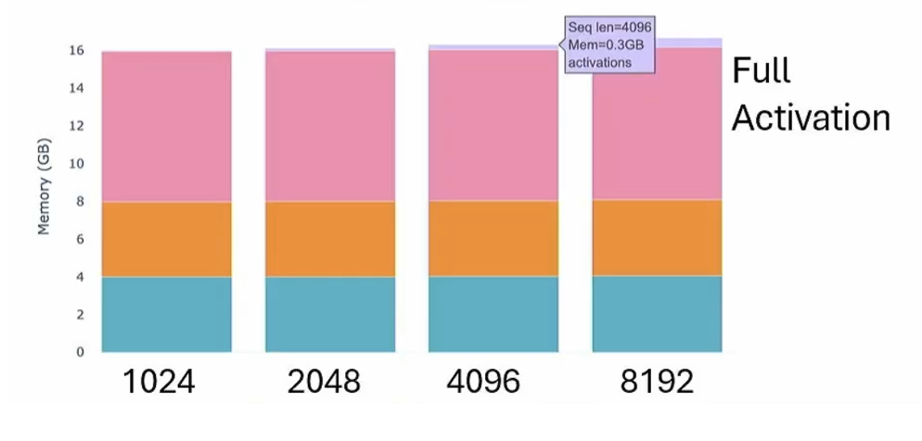

Slide 7
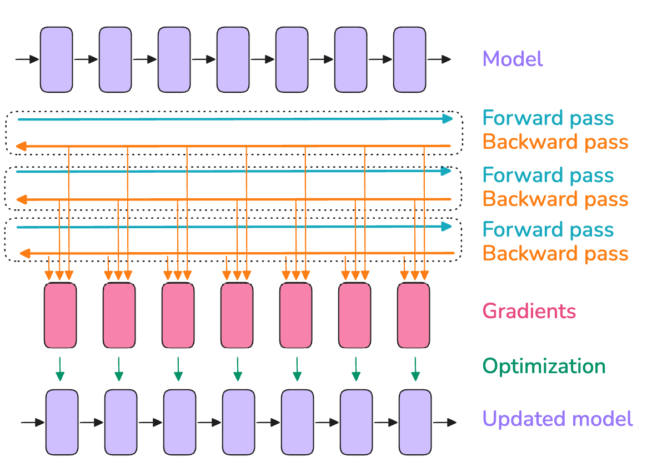
Micro-batch 1
Micro-batch 2
Micro-batch 3

Slide 8
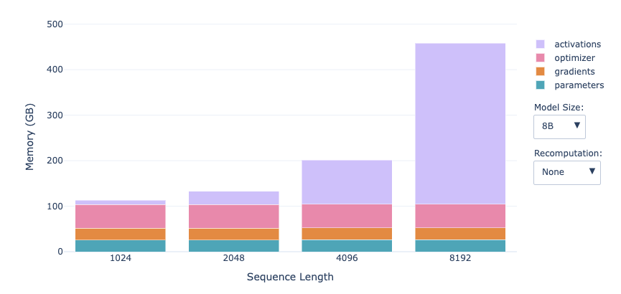
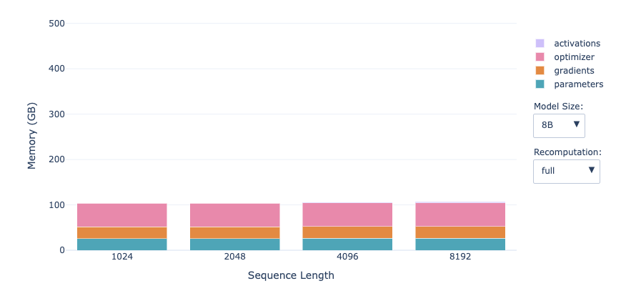
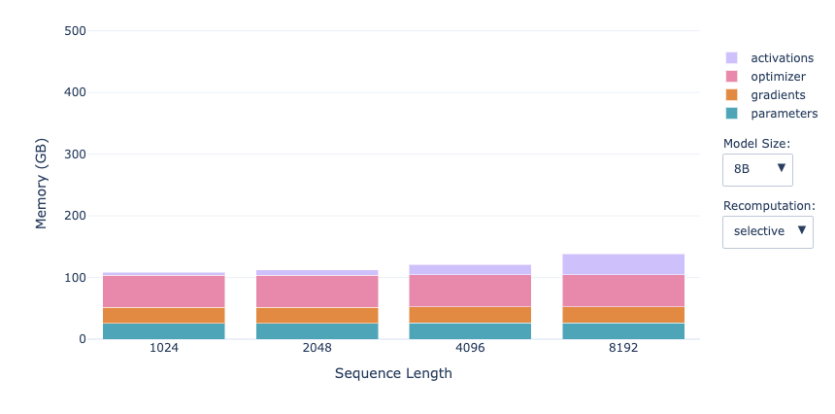
No Checkpointing
Full Activation
Selective Activation

Slide 9
Why we need to distribute our Training ?

Slide 10


Model
Data

Slide 11
Model
Data

Slide 12
Model
Model
Model
Model
Data
Data
Data
Data

Slide 13
Model
Model
Model
Model
Parameters
Gradients
Optimizer States
Data
Data
Data
Data

Slide 14
Model
Model
Model
Model
Parameters
Parameters
Parameters
Parameters
Gradients
Gradients
Gradients
Gradients
Optimizer States
Optimizer States
Optimizer States
Optimizer States
Data
Data
Data
Data

Slide 15

Model
Model
Model
Model
Parameters
Parameters
Parameters
Parameters
Gradients
Gradients
Gradients
Gradients
Optimizer States
Optimizer States
Optimizer States
Optimizer States
Forward

Slide 16

Model
Model
Model
Model
Parameters
Parameters
Parameters
Parameters
Gradients
Gradients
Gradients
Gradients
Optimizer States
Optimizer States
Optimizer States
Optimizer States
Forward
Backward

Slide 17
Model
Model
Model
Model
Parameters
Parameters
Parameters
Parameters
Gradients
Gradients
Gradients
Gradients
Optimizer States
Optimizer States
Optimizer States
Optimizer States
Forward
Backward

Slide 18

Model
Model
Model
Model
Parameters
Parameters
Parameters
Parameters
Gradients
Gradients
Gradients
Gradients
Optimizer States
Optimizer States
Optimizer States
Optimizer States
Forward
Backward
All-Reduce

Slide 19

Model
Model
Model
Model
Parameters
Parameters
Parameters
Parameters
Gradients
Gradients
Gradients
Gradients
Optimizer States
Optimizer States
Optimizer States
Optimizer States
Forward
Backward
All-Reduce

Slide 20
Model
Model
Model
Model
Parameters
Parameters
Parameters
Parameters
Gradients
Gradients
Gradients
Gradients
Optimizer States
Optimizer States
Optimizer States
Optimizer States

Slide 21
Model
Model
Model
Model
Parameters
Parameters
Parameters
Parameters
Gradients
Gradients
Gradients
Gradients
Optimizer States
Optimizer States
Optimizer States
Optimizer States
And it continues with a new batch of data

Slide 22
Model
Model
Model
Model
Parameters
Parameters
Parameters
Parameters
Gradients
Gradients
Gradients
Gradients
Optimizer States
Optimizer States
Optimizer States
Optimizer States
Distributed Data Parallel (DDP)

Slide 23
Model
Parameters
Gradients
Optimizer States
What if the Model doesn’t fit ?

Slide 24
Model
Parameters
Gradients
Optimizer States
What if the Model doesn’t fit ?
We have many options...

Slide 25
Model
Parameters
Gradients
Optimizer States

Slide 26
Model
Model
Model
Model
Parameters
Parameters
Parameters
Parameters
Gradients
Gradients
Gradients
Gradients
Optimizer States

Slide 27
Model
Model
Model
Model
Parameters
Parameters
Parameters
Parameters
Gradients
Gradients
Gradients
Gradients

Slide 28
Model
Model
Model
Model
Parameters
Parameters
Parameters
Parameters
Gradients
Gradients
Gradients
Gradients
ZeRO-1
optimizer state partitioning

Slide 29
Model
Model
Model
Model
Parameters
Parameters
Parameters
Parameters
Gradients
Gradients
Gradients
Gradients
Can we optimize further ?

Slide 30
Model
Model
Model
Model
Parameters
Parameters
Parameters
Parameters

Slide 31
Model
Model
Model
Model
Parameters
Parameters
Parameters
Parameters
ZeRO-2
optimizer state + gradient partitioning

Slide 32
Model
Model
Model
Model
Parameters
Parameters
Parameters
Parameters
Can we still optimize more?

Slide 33
Model
Model
Model
Model

Slide 34
Model
Model
Model
Model
ZeRO-3
optimizer state + gradient + parameter partitioning

Slide 35

Model
Model
Model
Model
ZeRO-3
FSDP
optimizer state + gradient + parameter partitioning
FSDP (Fully Sharded Data Parallelism)

Slide 36
ZeRO-3
FSDP
FSDP (Fully Sharded Data Parallelism)
optimizer state + gradient + parameter partitioning
Model
Model
Model
Model
Parameters
Gradients
Optimizer States

Slide 37
ZeRO-3
FSDP
FSDP (Fully Sharded Data Parallelism)
optimizer state + gradient + parameter partitioning
Sequentially go through the layers, we retrieve the necessary parameters on demand
Model
Model
Model
Model
Parameters
Gradients
Optimizer States
Forward

Slide 38
ZeRO-3
FSDP
FSDP (Fully Sharded Data Parallelism)
optimizer state + gradient + parameter partitioning
Sequentially go through the layers, we retrieve the necessary parameters on demand
Model
Model
Model
Model
Parameters
Gradients
Optimizer States
Forward
Ψ
All-Gather

Slide 39
ZeRO-3
FSDP
FSDP (Fully Sharded Data Parallelism)
optimizer state + gradient + parameter partitioning
Sequentially go through the layers, we retrieve the necessary parameters on demand
immediately flush them from memory when we don't need them anymore
Model
Model
Model
Model
Parameters
Gradients
Optimizer States
Forward
Ψ

Slide 40
ZeRO-3
FSDP
FSDP (Fully Sharded Data Parallelism)
optimizer state + gradient + parameter partitioning
Works the same way, just inverted in flow
Model
Model
Model
Model
Parameters
Gradients
Optimizer States
Forward
Backward
Ψ

Slide 41
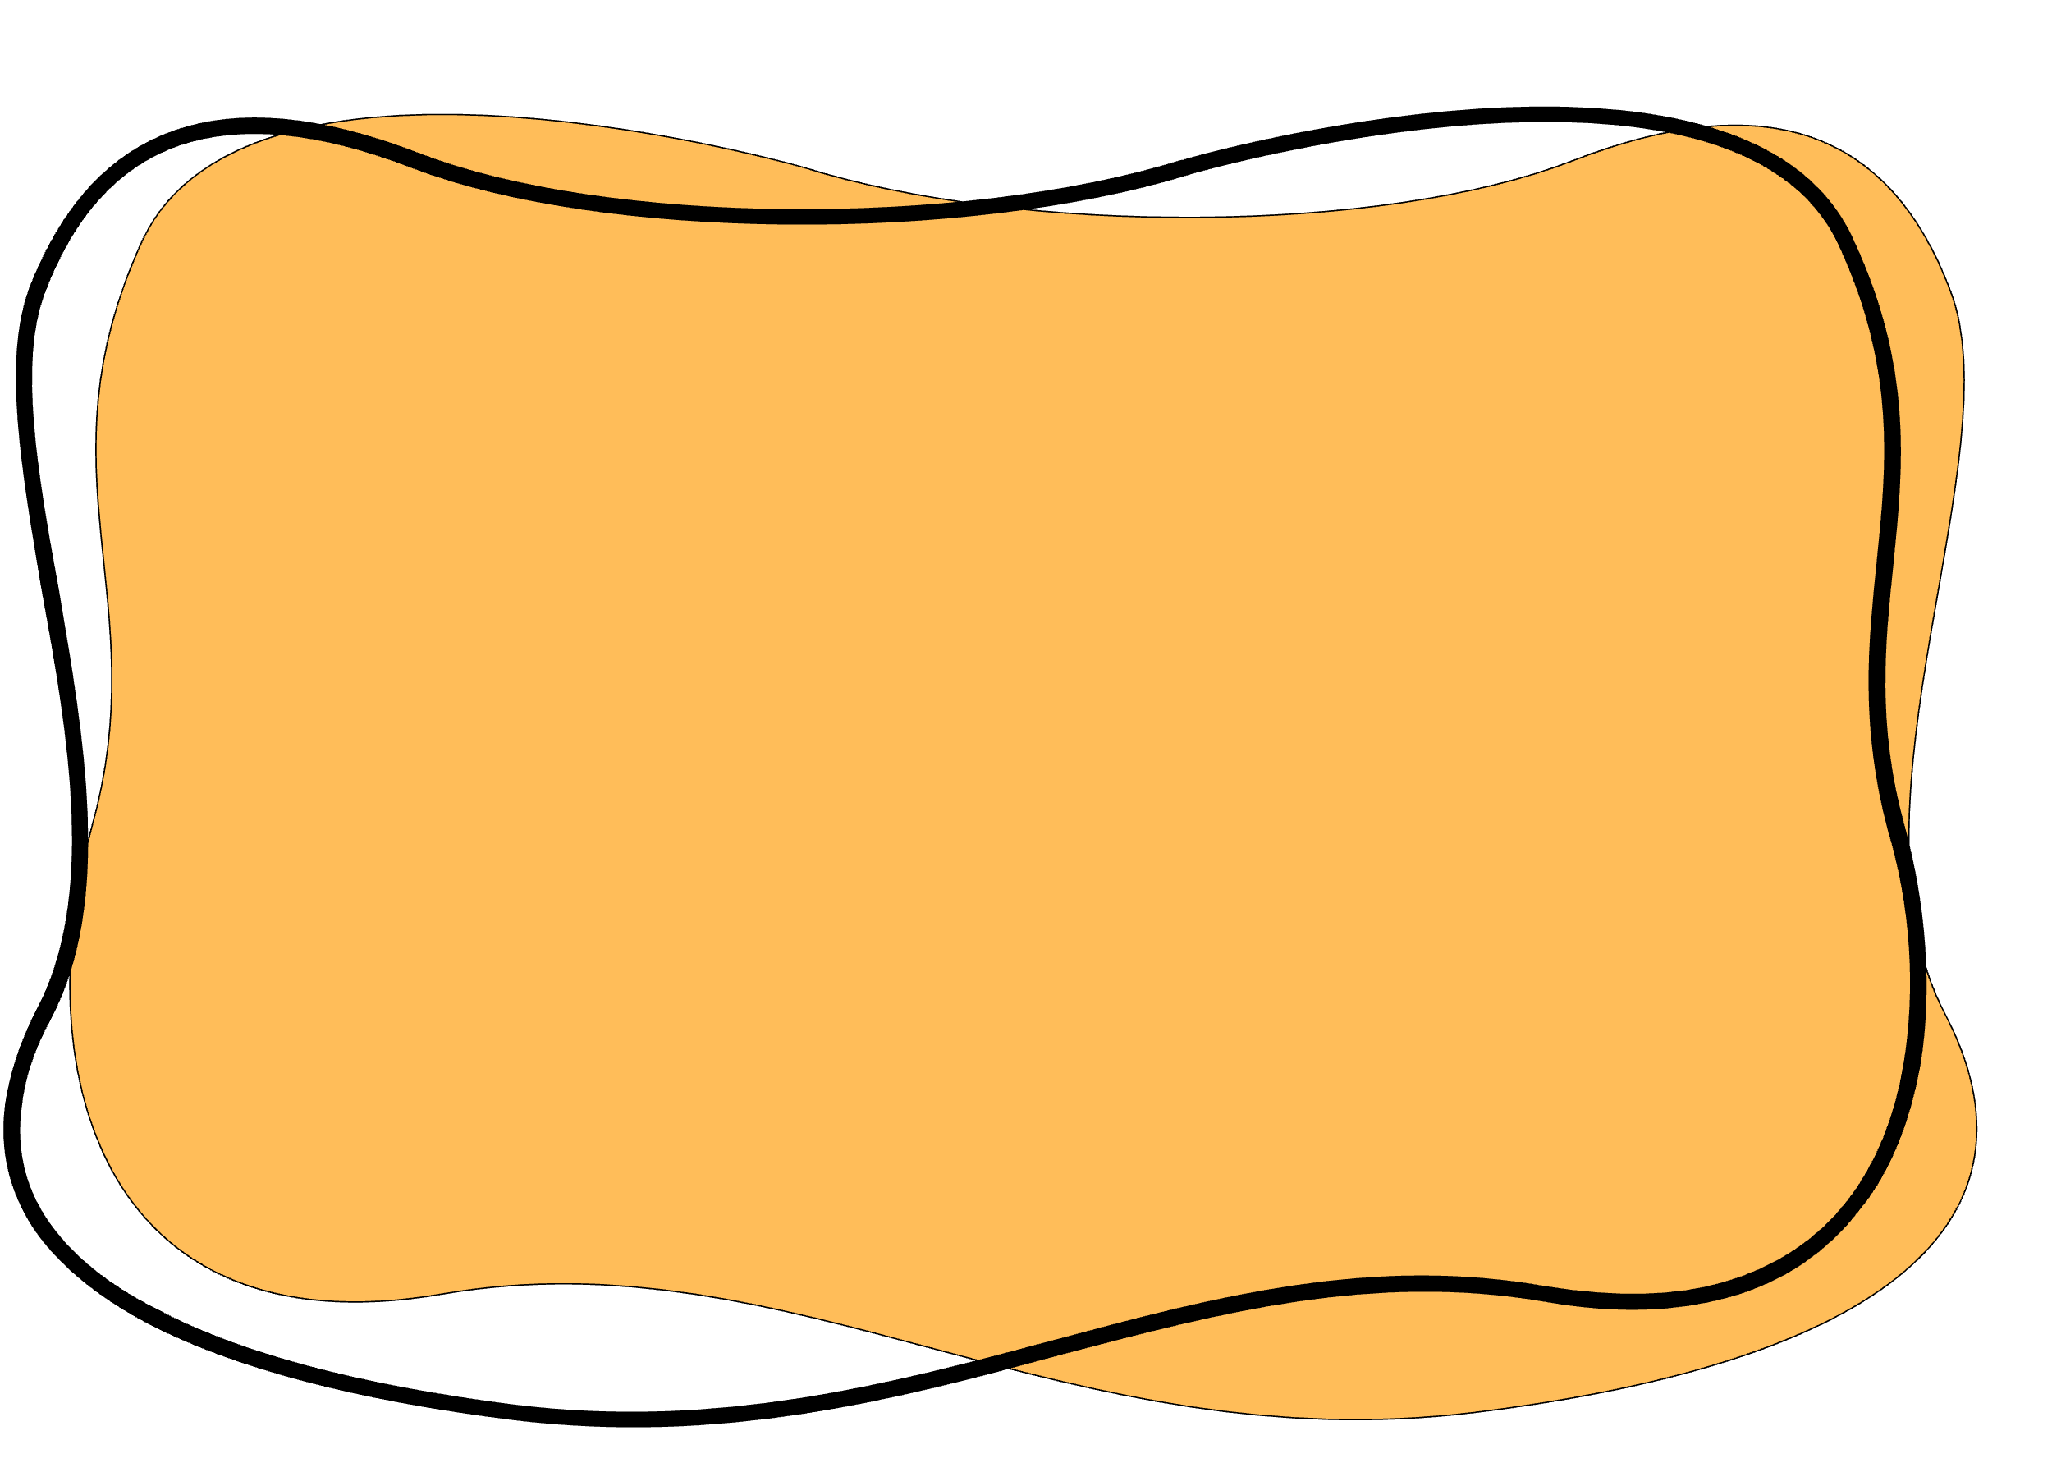
ZeRO-3
FSDP
FSDP (Fully Sharded Data Parallelism)
optimizer state + gradient + parameter partitioning
Works the same way, just inverted in flow
we do all-gather operations for the parameters
Model
Model
Model
Model
Parameters
Gradients
Optimizer States
Forward
Backward
Ψ
Ψ
All-Gather

Slide 42
ZeRO-3
FSDP
FSDP (Fully Sharded Data Parallelism)
optimizer state + gradient + parameter partitioning
Works the same way, just inverted in flow
produce the gradient shards
Model
Model
Model
Model
Parameters
Gradients
Optimizer States
Forward
Backward
Ψ
Ψ
Reduce-scatter
Ψ

Slide 43

ZeRO-3
FSDP
FSDP (Fully Sharded Data Parallelism)
optimizer state + gradient + parameter partitioning
Model
Model
Model
Model
Parameters
Gradients
Optimizer States
Total Communication Tax
Forward
Backward
Ψ + Ψ + Ψ = 3 Ψ

Slide 44
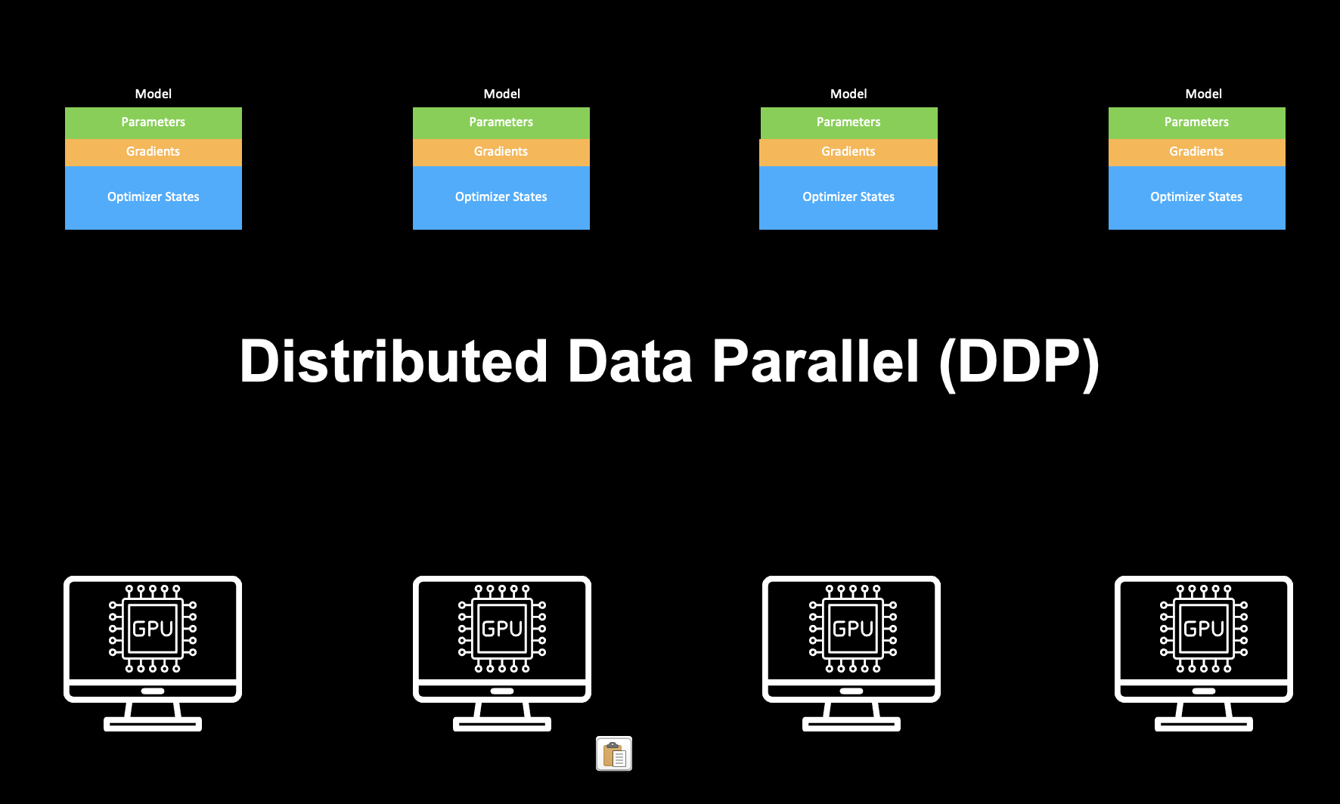
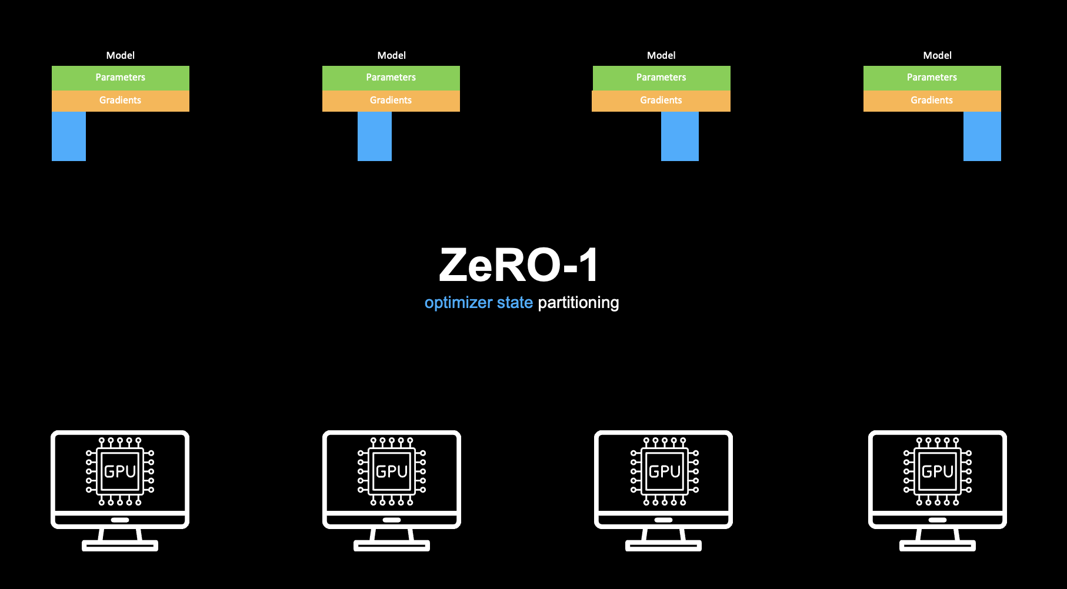
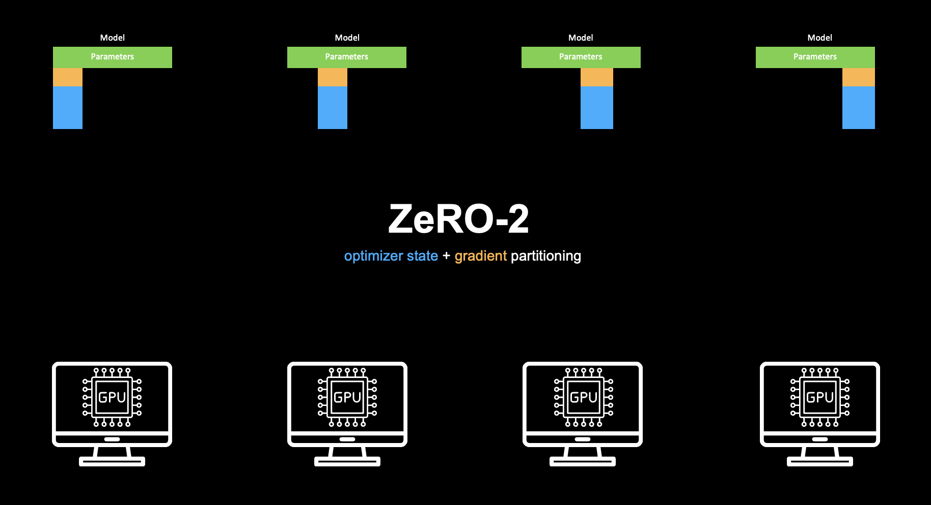
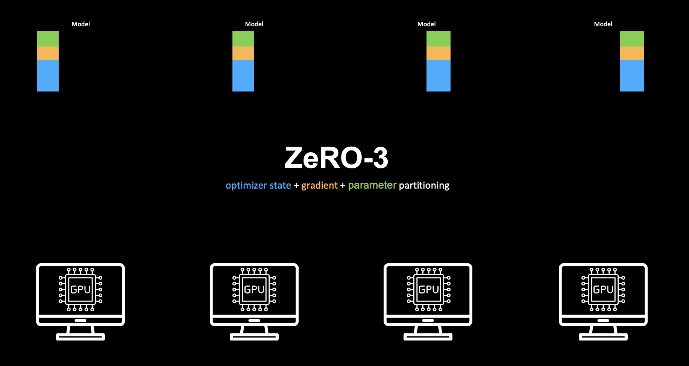

Slide 45
Data Parallel

Slide 46
Data Parallel
Each GPU still computes the full model forward and backward on its batch of data
Conceptually identical to Data Parallelism.

Slide 47
Data Parallel
Each GPU still computes the full model forward and backward on its batch of data
Conceptually identical to Data Parallelism.
What they do change is how the model’s parameters are stored in memory across GPUs.

Slide 48
Can we scale further ?
Data Parallel
Each GPU still computes the full model forward and backward on its batch of data
Conceptually identical to Data Parallelism.
What they do change is how the model’s parameters are stored in memory across GPUs.

Slide 49
Tensor Parallel
Pipeline Parallel
Expert Parallel
...
Data Parallel
Each GPU still computes the full model forward and backward on its batch of data
Conceptually identical to Data Parallelism.
What they do change is how the model’s parameters are stored in memory across GPUs.

Slide 50

RAY
Notes:
Ray is a distributed compute engine

Slide 51
RAY
Unifies the AI ecosystem
Notes:
…which unifies the AI ecosystem.

Slide 52
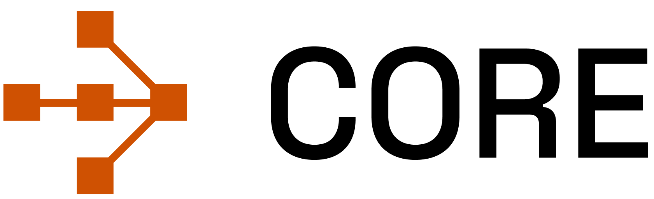
Core
Unifies the AI ecosystem
Notes:
At its core we have Ray Core, which is the compute engine.
Which you can use to scale any Python Code across 100s and 1000s of machine at scale with CPU, GPU and other accelerators.

Slide 53
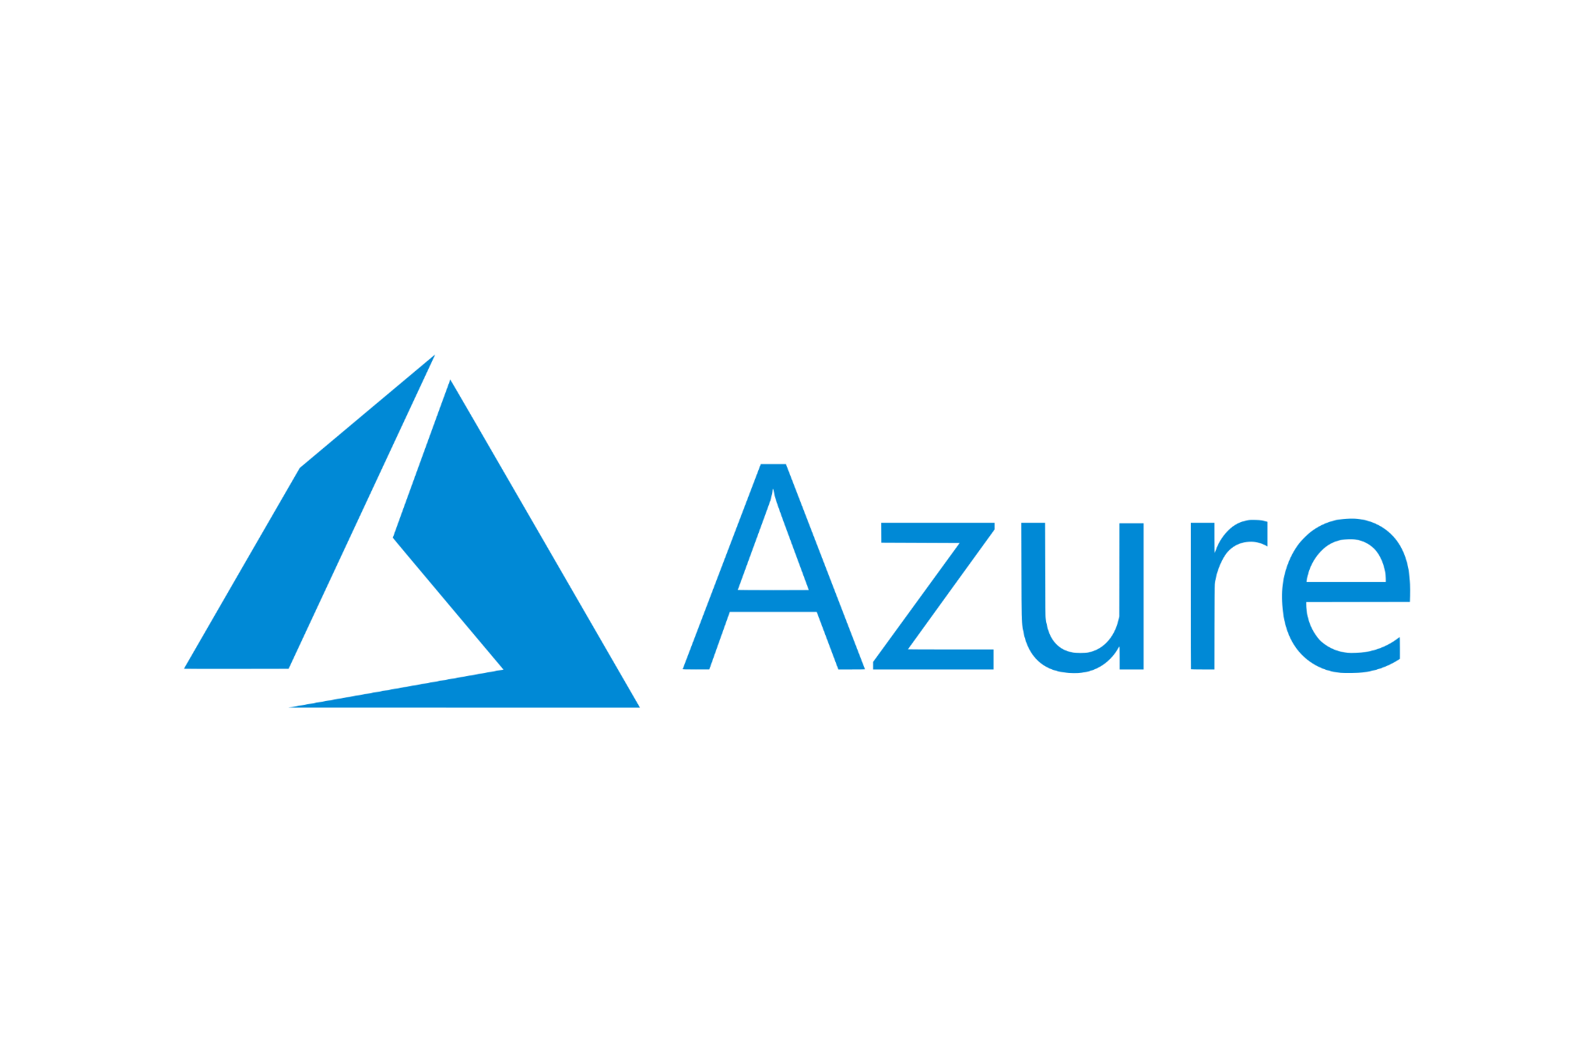






Core
Unifies the AI ecosystem
Runs wherever your hardware is
Notes:
It can run on any hardware of your choice, be it on cloud or on premise or even on your laptop.

Slide 54
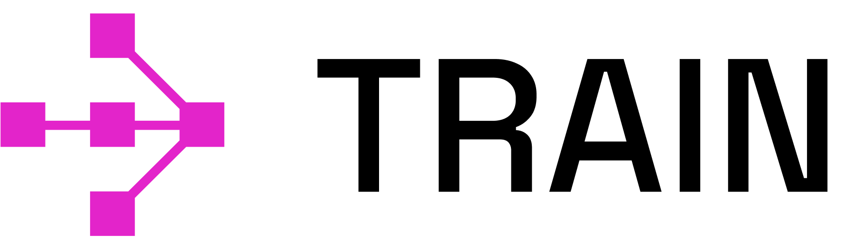

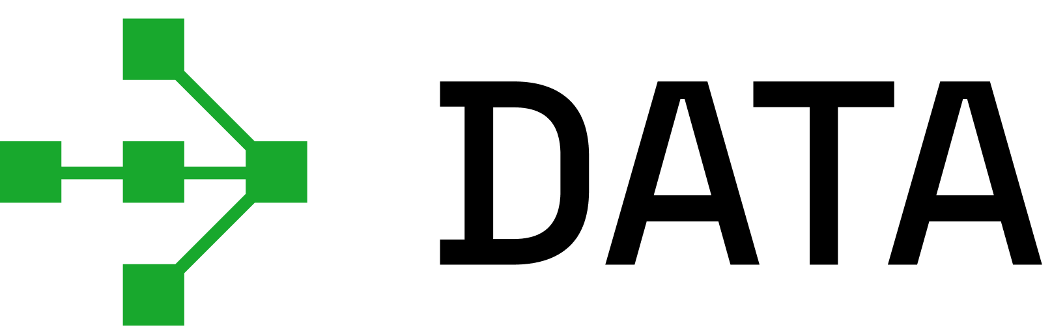

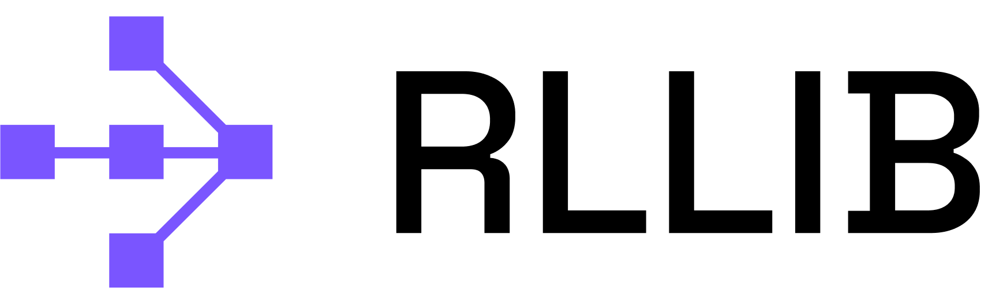
Ray Native Libraries
Serve
Train
Empowers AI/ML practitioners
RLlib
Data
Tune
Core
Unifies the AI ecosystem
Runs wherever your hardware is
Notes:
We have many different libraries for different AI workload, like
Ray Train for Distributed Training
Ray Data for Multimodal Data processing
Ray Server for Large Scale inference
and so on ….

Slide 55

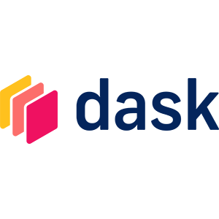



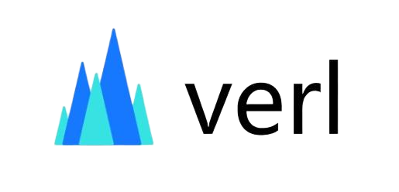
Ray Native Libraries
Integrated Ecosystem
Serve
Train
Empowers AI/ML practitioners
RLlib
Data
Tune
Core
Unifies the AI ecosystem
Runs wherever your hardware is
Notes:
Not only that, Ray can be used with different framework and engines, like PyTorch, Hugging Face, vLLM, etc.

Slide 56

Ray Native Libraries
Integrated Ecosystem
Train
Empowers AI/ML practitioners
Let’s take an example with PyTorch and Ray Train
Core
Unifies the AI ecosystem
Runs wherever your hardware is
Notes:
For this demo, we will use PyTorch and Ray Train and will see how we can perform a Distributed Training with them at scale.

Slide 57
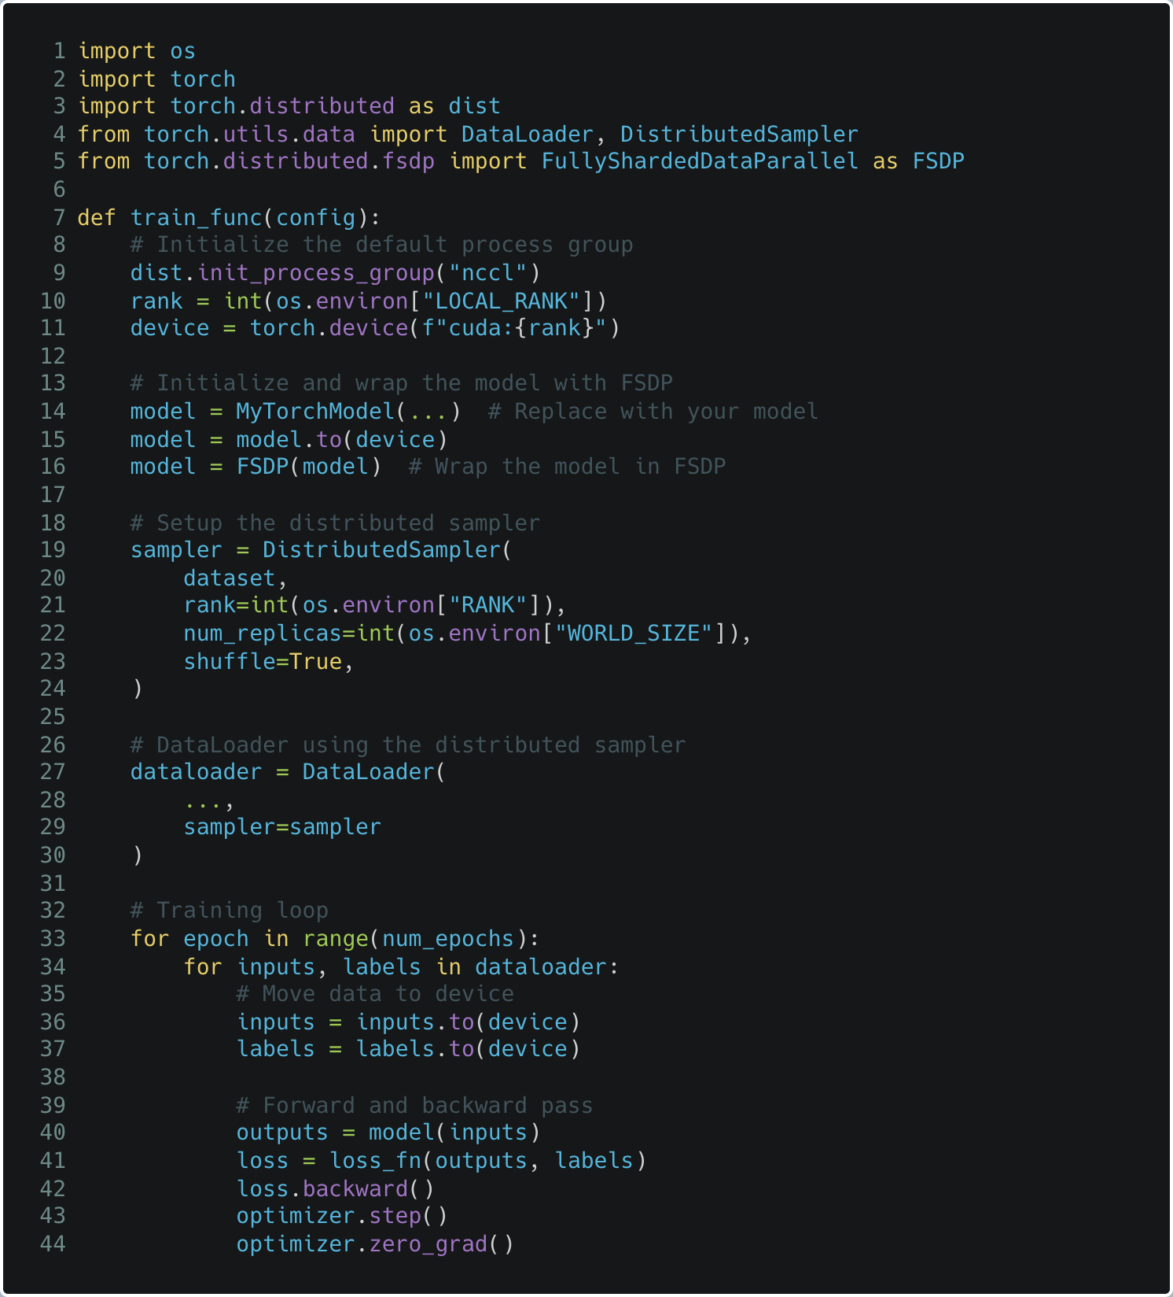
Setup
distributed env
Setup
FSDP model
Setup
distributed sampler
Move
batches to GPU
Notes:
Before we see Ray Train and its value, lets see how you would typically perform this distributed training using PyTorch
First, you need to define the training function which you expect to all your machines and GPUs and you do that by setting up “Initializing a Process Group” as you can see in line # 9

Slide 58
Setup
distributed env
Setup
FSDP model
Setup
distributed sampler
Move
batches to GPU
Notes:
Then you prepare your model, like in this case we want to use FSDP so we are wrapping our model with FSDP implementation of PyTorch as you can see in line #16

Slide 59
Setup
distributed env
Setup
FSDP model
Setup
distributed sampler
Move
batches to GPU
Notes:
And then we need to prepare the dataloader as we it’s a distributed training, we can not send the dataloader directly to the training function
But we need to wrap it around ”DistributedSampler” which tells PyTorch that this is a distributed training and it should distributed different micro-batch to different GPUs as Suman mentioned earlier while explaining different data parallel techniques

Slide 60
Setup
distributed env
Setup
FSDP model
Setup
distributed sampler
Move
batches to GPU
Notes:
Lastly you just run the training

Slide 61
Setup
distributed env
Setup
FSDP model
Setup
distributed sampler
Let’s see how it works with Ray Train
Train
Move
batches to GPU
Notes:
Lets see how things changes with Ray Train

Slide 62

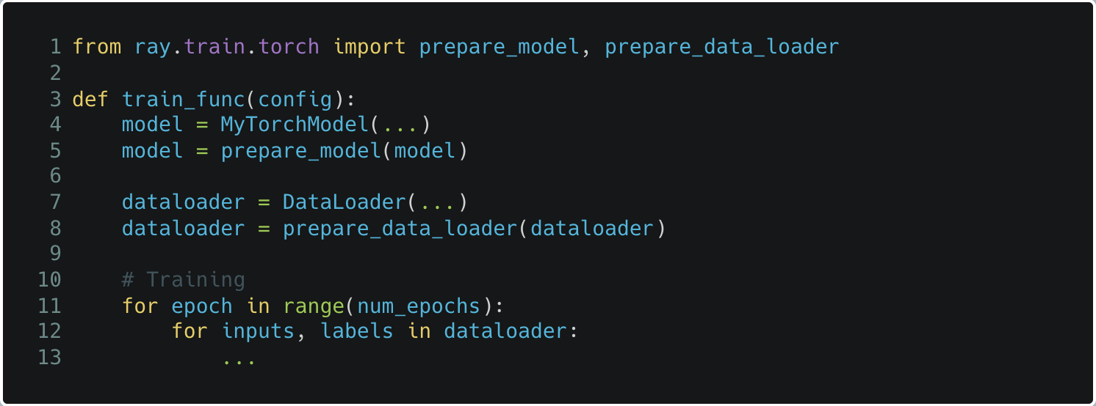
Setup
distributed env
Setup
FSDP model
Setup
distributed sampler
Let’s see how it works with Ray Train
Train
Move
batches to GPU
Notes:
With Ray Train, you first import ”prepare_model” and “prepare_data_loader” from Ray Train as you can see in line #1
And prepare your model and dataset with them,
As you can see there is no need to use Distributed Sampler separately, Ray Train would take care of that under the hood.

Slide 63

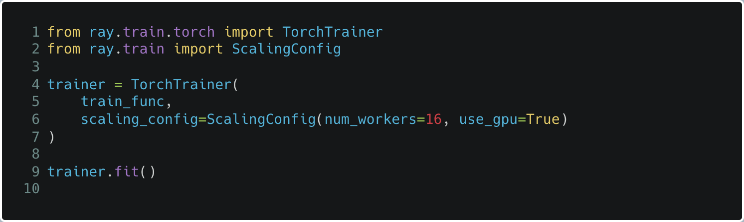
Setup
distributed env
Setup
FSDP model
Setup
distributed sampler
Let’s see how it works with Ray Train
Train
Move
batches to GPU
Notes:
And finally, you put both of them together within “TorchTrainer” by mentioned some sonfiguration details like ScalingConfig here where you specify how you want to scale and if you would like to use GPU or not.
For example, here we are saying to run this training in 16 workers with 1 GPU in each worker.

Slide 64
But what is happening under the hood ?
Let’s see how it works with Ray Train
Train
Notes:
But wht is happening under the hood ? Lets take a look what ray is doing here once we start the training and run “trainer.fit()”

Slide 65
Training Function
Notes:
Let’s say this is our training function which we want our FSDP to run in all the workers

Slide 66
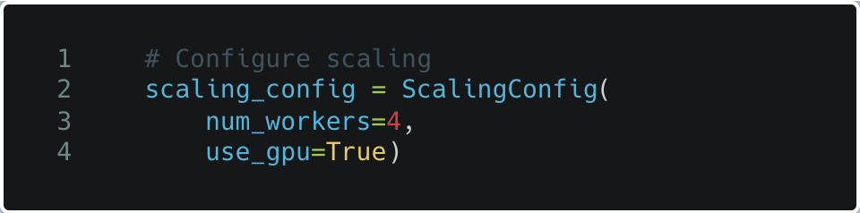
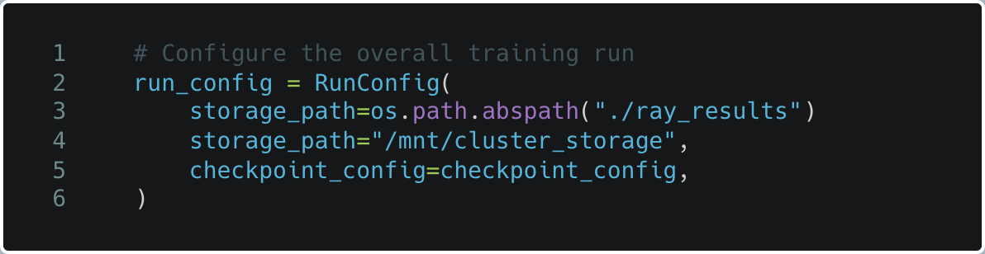
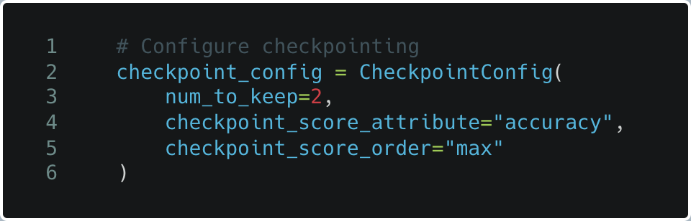
Training Function
Scaling Configuration
Running Configuration
Checkpoint Configuration
Notes:
And here are the different configuration details which we need to provide to Ray, like Scaling Configuration like we saw a while back and other configurations like checkpointing, etc.

Slide 67
Train
Training Function
Scaling Configuration
Running Configuration
Checkpoint Configuration
Notes:
And together we make them work with Ray Train. Let see the code again,

Slide 68
Train
Training Function
Scaling Configuration
Running Configuration
Checkpoint Configuration
from ray.train.torch import TorchTrainer
Notes:
We import TorchTrain from Ray Train

Slide 69
Train
Training Function
Scaling Configuration
Running Configuration
Checkpoint Configuration
from ray.train.torch import TorchTrainer
from ray.train import ScalingConfig, RunConfig, CheckpointConfig
Notes:
Then we import
ScalingConfig
RunConfig and
CheckpointConfig

Slide 70
Train
Training Function
Scaling Configuration
Running Configuration
Checkpoint Configuration
from ray.train.torch import TorchTrainer
from ray.train import ScalingConfig, RunConfig, CheckpointConfig
# Create TorchTrainer
trainer = TorchTrainer(train_loop_per_worker = train_func_per_worker,
train_loop_config = train_config,
scaling_config = scaling_config,
run_config = run_config)
Notes:
And use “TorchTrainer” to put together everything

Slide 71
Train
Training Function
Scaling Configuration
Running Configuration
Checkpoint Configuration
from ray.train.torch import TorchTrainer
from ray.train import ScalingConfig, RunConfig, CheckpointConfig
# Create TorchTrainer
trainer = TorchTrainer(train_loop_per_worker = train_func_per_worker,
train_loop_config = train_config,
scaling_config = scaling_config,
run_config = run_config)
# Start training
result = trainer.fit()
Notes:
And finally we start the training using trainer.fit()

Slide 72
Train
Training Function
Scaling Configuration
Running Configuration
Checkpoint Configuration
from ray.train.torch import TorchTrainer
from ray.train import ScalingConfig, RunConfig, CheckpointConfig
# Create TorchTrainer
trainer = TorchTrainer(train_loop_per_worker = train_func_per_worker,
train_loop_config = train_config,
scaling_config = scaling_config,
run_config = run_config)
# Start training
result = trainer.fit()
Ray Cluster
Worker 1
Worker 2
Worker 3
Worker 4
Notes:
Under the hood, the Ray would take the training function and start to run in a distributed fashion on multiple machines as per the Scaling Config
And it would take care of scheduling, fault tolerance and auto scaling for your distributed training job.
So, its as simple as this, you do not need to be a distributed system expert to run distributed training at scale.
You can simply use your training code which you run on your laptop and scale to 1000s of machine without any hindrance.
Now, let me hand it over to Suman to conclude…

Slide 73
RAY
https://ray.io
Notes:
To learn more you can

Slide 74



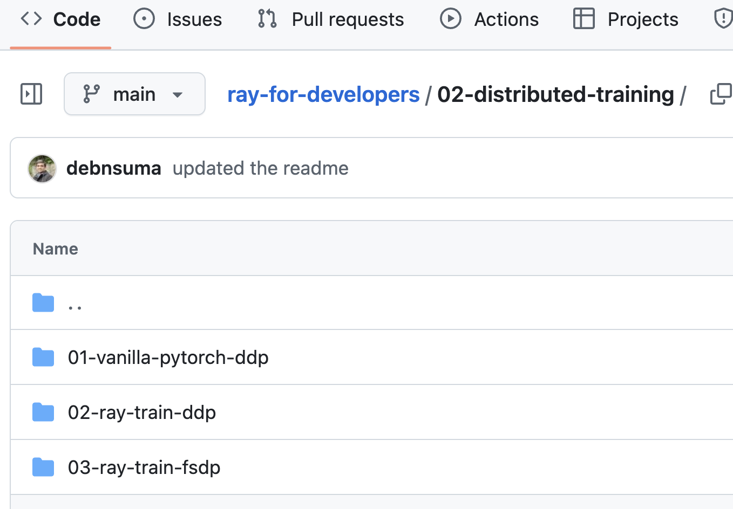
GitHub

Slide 75

The slides
GitHub

Slide 76
THANK YOU.

